Slide 1
MSS-400 Shared memory
July 2023

Slide 2
Shared Memory 1/4
New SW Architecture
NEW Info Model
Storage
dpManager
oduCntrl
chData
Process n …
NOKIA
PLM
libshareddata.so
libshareddata.so
libshareddata.so
libshareddata.so
SHARED MEMORY
(not persistent storage)
Legacy PLM DB

Slide 3
Shared Memory 2/4
Linux Posix Shared Memory
dpManager
W mutex
Discovery Prot section
DP offset
Discovery Protocol section
Odu section
ODU offset
RW mutex
oduCntrl
Discovery Protocol section
Odu section
XXX section
XXX offset
chData1
Odu section

Slide 4
Shared memory 3/4
Shared library exporting API to manage shared memory based on OSAL completed; new dev folder sharedData
First prototype of IPC shared mem : completed. Share DP info between oduCntrl process and dpManager process
Unique shared mem with different section: processes will load in their own space only required sections
Mutex added: usage (W or RW) depending on shared data section.

Slide 5
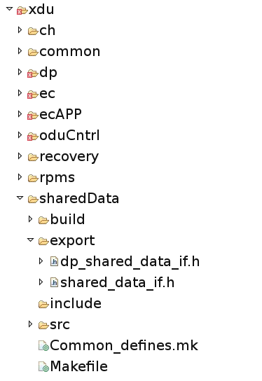
Shared memory 4/4
Dev FS

Slide 7
Copyright and confidentiality
The contents of this document are proprietary and confidential property of Nokia. This document is provided subject to confidentiality obligations of the applicable agreement(s).
This document is intended for use by Nokia’s customers and collaborators only for the purpose for which this document is submitted by Nokia. No part of this document may be reproduced or made available to the public or to any third party in any form or means without the prior written permission of Nokia. This document is to be used by properly trained professional personnel. Any use of the contents in this document is limited strictly to the use(s) specifically created in the applicable agreement(s) under which the document is submitted. The user of this document may voluntarily provide suggestions, comments or other feedback to Nokia in respect of the contents of this document ("Feedback"). Such Feedback may be used in Nokia products and related specifications or other documentation. Accordingly, if the user of this document gives Nokia Feedback on the contents of this document, Nokia may freely use, disclose, reproduce, license, distribute and otherwise commercialize the feedback in any Nokia product, technology, service, specification or other documentation.
Nokia operates a policy of ongoing development. Nokia reserves the right to make changes and improvements to any of the products and/or services described in this document or withdraw this document at any time without prior notice.
The contents of this document are provided "as is". Except as required by applicable law, no warranties of any kind, either express or implied, including, but not limited to, the implied warranties of merchantability and fitness for a particular purpose, are made in relation to the accuracy, reliability or contents of this document. NOKIA SHALL NOT BE RESPONSIBLE IN ANY EVENT FOR ERRORS IN THIS DOCUMENT or for any loss of data or income or any special, incidental, consequential, indirect or direct damages howsoever caused, that might arise from the use of this document or any contents of this document.
This document and the product(s) it describes are protected by copyright according to the applicable laws.
Nokia is a registered trademark of Nokia Corporation. Other product and company names mentioned herein may be trademarks or trade names of their respective owners.

